Slide 1
Governance In Azure

Slide 2
The three main questions of GRC
What do you need to do?
How are you going to do it?
Did you do what you said you were going to do?

Slide 3
GRC Simplified
Governance
What do you need to do?
Why do you need to do it?
What are you going to do?
How are you going to do it?
Risk
What is the delta between what you need to do and what you said you were going to do?
What is the delta between what you need to do and what you you did?
What is the delta between what you said you would do and what you did?
Compliance
What did you / are you doing?
Did you / are you doing what you said you were going to do?
Did you / are you doing what you are supposed to do?

Slide 4
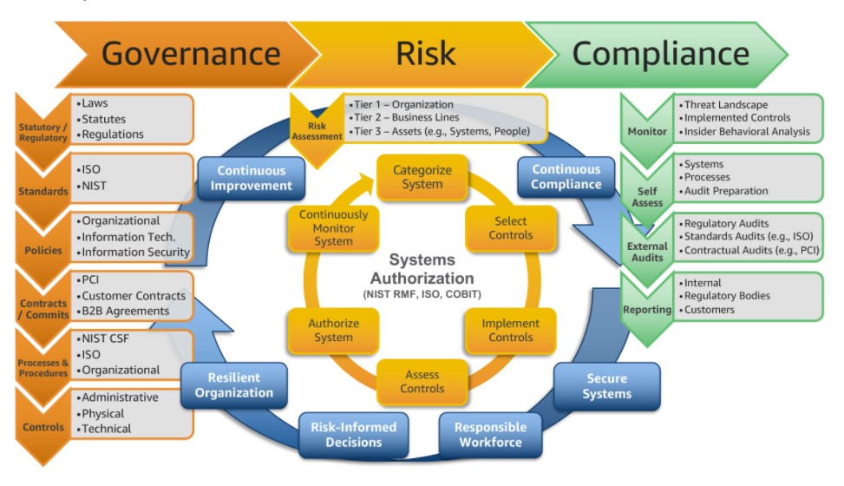
GRC

Slide 5
Governance Control Mapping Flow
Customer Onboarding Azure Services
Platform Level Controls
Control set Assessment
PLAN
DESIGN
IMPLEMENT
Current Common Process
Remaining Controls
(Customer Responsibility)
Microsoft Provided Controls
(Microsoft Responsibility)
Assess
Microsoft Recommends start with Azure Security Benchmark
Map benchmark to customer controls and update benchmark technical controls where applicable
Create custom Azure Policies to fill gaps between benchmarks and customers controls
4. Create processes/procedures to fill gaps of what cannot be done in Azure Policy
5. Apply Azure Policies to customers environment to Audit and optionally enforce compliance
6. Audit environment against controls with Azure Defender for Cloud or other 3rd party.
7. Establish service approval process to create baseline for new services leveraging azure security benchmarks
8. Optionally Update azure policy to enforce azure security benchmarks
Evaluate Remaining Controls
(against Platform Services)
Microsoft Controls (Trust Center)
Asses
Customer Control Set
Map
ASB
map
Customer
Customer
SOC2\NIST\PCI
CIS\FedRamp
Customer policies
Built-In policies
NIST\CIS
→ Built-In Policies
Implement
Implement
Notes:
Microsoft recommends starting with the Azure Security Benchmark as it is the strategic path forward and all new services are being built with an Azure Security Benchmark with the recommended configuration and best practices. However, in organizations where there already exists an organizational framework built off of common frameworks like CIS, NIST, FedRAMP then it may make sense to start with those Azure Benchmarks.
Benchmarks represent opinionated technical baselines. In most cases an organization will choose to update the baseline to more closely align with their organizational standards and practices. For instance, every control framework has a requirement to utilize an Antivirus and each Azure Benchmark (being opinionated) calls for the use of Microsoft Defender but not every customer uses Defender. So in those cases the benchmark will be updated to accommodate the customers organizational controls.
In some cases the Azure Benchmark Initiative will not have policies to meet the organizational needs, like in the previous scenario where an AV other than defender is in use. In these scenarios the organization may choose to create custom azure policies to fill these gaps.

Slide 6
Azure Policy Overview

Slide 7
Azure Policy
IT Governance ensures that your organization can achieve its goals through an effective and efficient use of IT. It does this by creating clarity between your business goals and IT projects.
Azure Policy is a service in Azure that you use to create, assign and, manage policies. These policies enforce different rules and effects over your resources, so those resources stay compliant with your corporate standards and service level agreements.
Azure Policy does this by running evaluations of your resources and scanning for those not compliant with the policies you have created.
Notes:
https://docs.microsoft.com/en-us/azure/azure-policy/azure-policy-introduction
For example, you can have a policy to allow only a certain SKU size of virtual machines in your environment. Once this policy has been implemented, it will then be evaluated when creating and updating resources, as well as over your already existing resources.

Slide 8
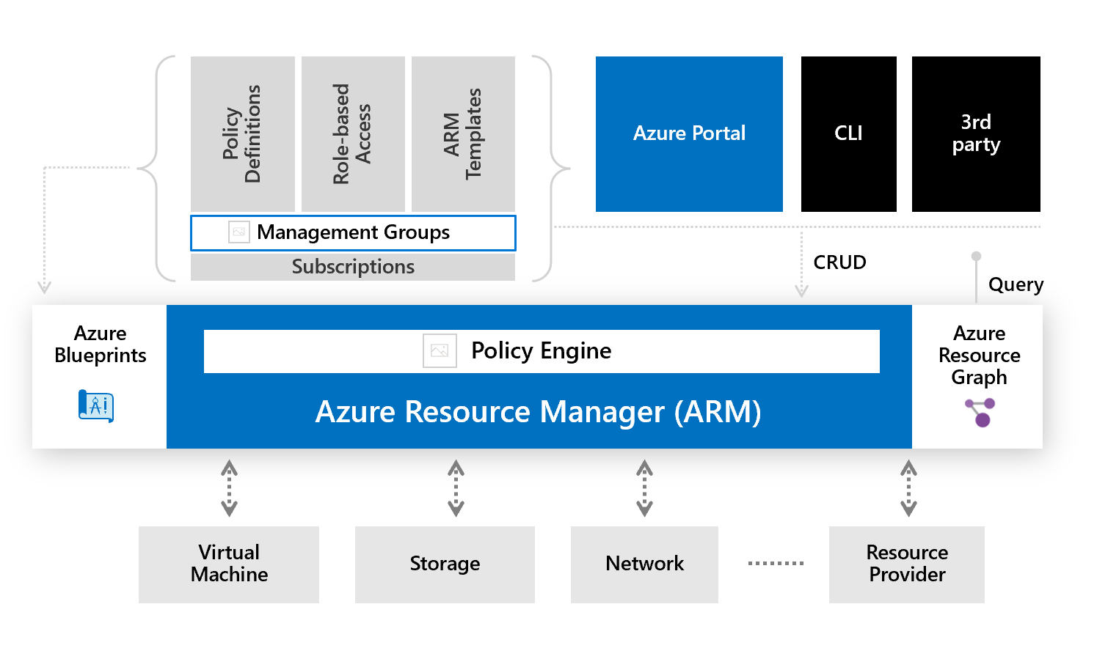
Azure Policy
Enforce organizational governance and compliance
Evaluates resource properties
Enforced as request flows through ARM API
Policies consist of a definition and an assignment
Policies can be consolidated into an initiative
Assign policy at the management group, subscription, resource group, and resource level
Notes:
Policy and initiative definitions are stored at management group or subscription level
Resources
https://docs.microsoft.com/en-us/azure/governance/policy/overview
https://journeyofthegeek.com/2019/09/15/tips-and-tricks-for-writing-azure-policy/

Slide 9
ASBs provides a canonical set of Azure-centric technical security controls based on widely used security/compliance control frameworks such as CIS, NIST and PCI.
Azure Security Benchmarks Security Control Coverage
CIS Controls
Non-Technical
Non-Azure
Azure Technical
Non-Azure
ASB Controls
Non-Technical
Azure Technical
Azure Technical
PCI Controls
NIST Controls
Non-Technical
Non-Azure
 | ASB Control Coverage
 | Other Framework Control Coverage

Slide 10

Azure Policy
Turn on built-in policies or build custom ones for all resource types
Apply policies to a Management Group with control across your entire organization
Real time remediation
Real-time policy evaluation and enforcement
Apply multiple policies and & aggregate policy states with policy initiative
Remediation on existing resources
Periodic & on-demand compliance evaluation
Exclusion Scope
VM In-Guest Policy (Preview)
Enforcement & Compliance
Apply policies at scale
Remediation
Notes:
https://docs.microsoft.com/en-us/azure/azure-policy/azure-policy-introduction
https://azure.microsoft.com/en-us/updates/guest-configuration-feature-for-azure-policy-now-in-preview/

Slide 11
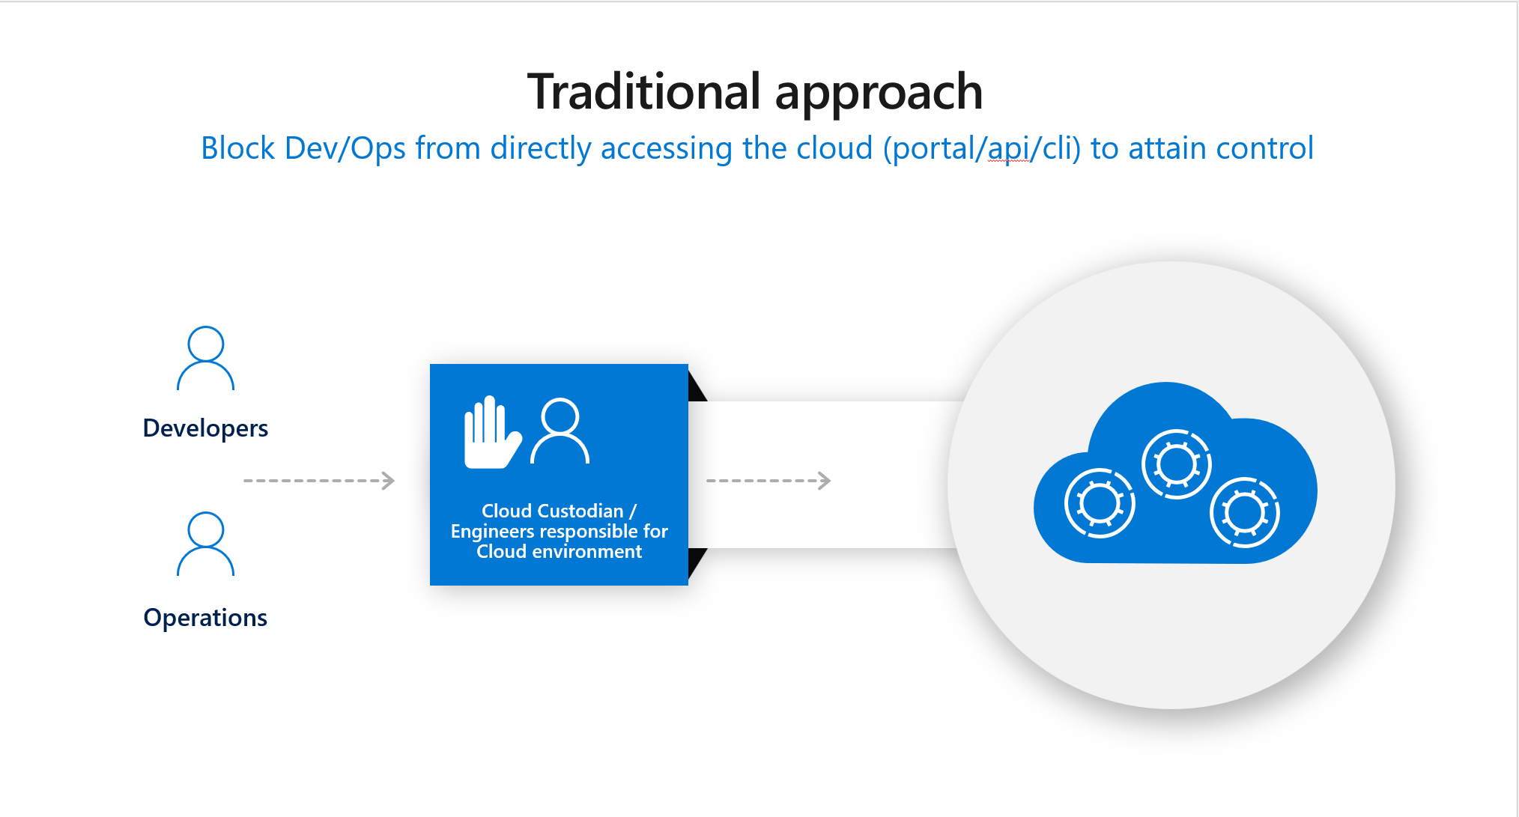
Notes:
In a “Traditional Enterprise” model, IT enforces what is released and stops everyone with rigid processes and procedures. Nothing moves until the IT team gives the green light. This causes a miss alignment between the Development teams that are mostly agile, focused on speed, expecting to release as often has they wishes. IT Governance in fact seems as a bottleneck that isn’t aligned to the expected Time to Market objectives of nowadays business needs.

Slide 12
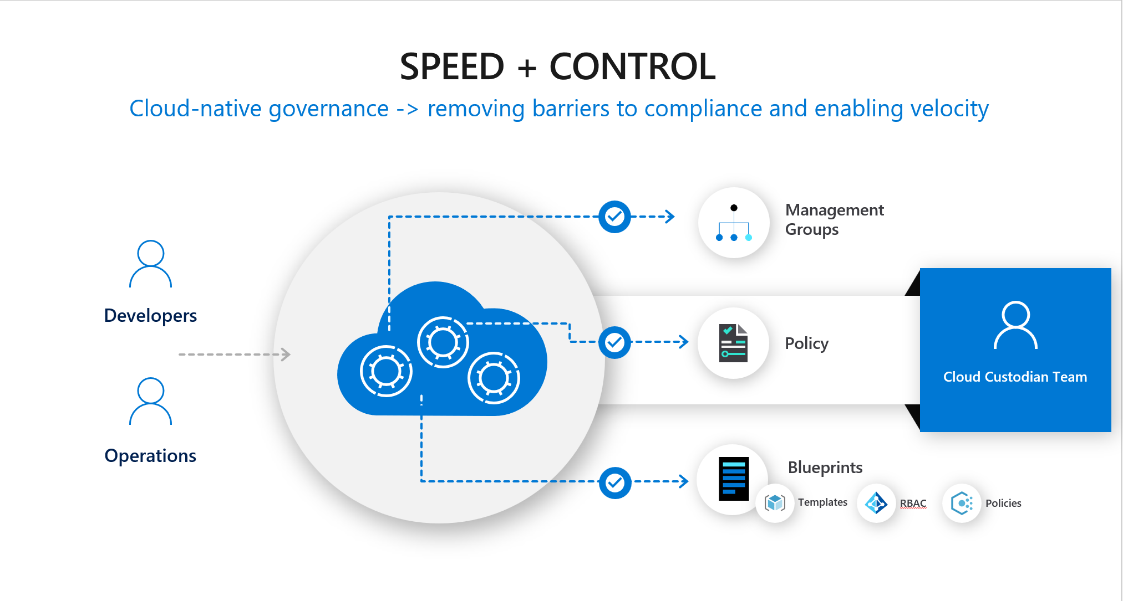
Notes:
But with Digital Transformation, modern app, intelligent edge, IT can not operate using the same Command and Control strategy. In a Digital Transformed “Modern Enterprise”, which is the new world, Modern Apps and Cloud Services are released to end users and developers in a rapid and agile manner. This requires more facilitation of self governance and the framework that enables coordination vs. enforcement.
Modern IT Service Management embodies this new strategy, empowers dev, ops and end-users, allowing free movement in a coordinated, self governed fashion. It leaves Command and Control of the “Traditional Enterprise” behind. Azure Mechanism offer the flexibility to implement governance is a delegated mode with modern Service management practices.
This is impersonated by the Cloud Custodian. He/She is a person or team responsible for defining and implementing cloud policies and security controls in a delegated world, using Azure Blueprints, templates, RBAC and policies to govern cloud usage while allowing flexibility at the same time.

Slide 13


Azure Policies - Definition
Mode
Parameters*
Display name
Description
Policy rule
Policy Definition
Policy
Notes:
Azure Policy is a service in Azure that you use to create, assign, and manage policies. These policies enforce different rules and effects over your resources, so those resources stay compliant with your corporate standards and service level agreements. Azure Policy meets this need by evaluating your resources for non-compliance with assigned policies.
You use JSON to create a policy definition. The policy definition contains elements for:
mode
Parameters -> Next slide covers parameters
display name
description
policy rule

Slide 14



Azure Policies - Parameters
Assign Parameter
Management Group
Assign Parameter
Parameters
Subscription
Policy Definition
Policy
Assign Parameter
Resource Group
Notes:
Policy parameters help simplify your policy management by reducing the number of policy definitions you must create. You can define parameters when creating a policy definition to make it more generic. Then you can reuse that policy definition for different scenarios. You do so by passing in different values when assigning the policy definition.

Slide 15
Azure Policies – Assignment Scope
Policy is a default allow system. You control actions by defining and assigning policies to resources that deny or audit actions on resources.
Policies are described by policy definitions in a policy definition language (if-then conditions).
You create polices with JSON (JavaScript Object Notation) formatted files. After defining a policy, you assign it to a scope e.g. Management Group, Subscription, Resource Group, or Resource.
Management Group
Azure Policy
Resource Group
Azure Policy
Resource
Azure Policy
Subscription
Azure Policy

Slide 16
Azure Policies - Effects
Policy Effect | Description
Disabled | This effect is useful for testing situations or for when the policy definition has parameterized the effect. This flexibility makes it possible to disable a single assignment instead of disabling all of the policy's assignments.
Append | Alter resource before deploy. Append is used to add additional fields to the requested resource during creation or update. If policy conflicts with fields in deployment then it acts as a Deny.
Modify | Modify is used to add, update, or remove tags on a resource during creation or update
Deny | Deny is used to prevent a resource request that doesn't match defined standards through a policy definition and fails the request. For existing resources, no action is taken and resource is simply marked non-compliant
Audit | Audit is used to create a warning event in the activity log when evaluating a non-compliant resource, but it doesn't stop the request.
AuditIfNotExists | AuditIfNotExists enables auditing on resources related to the resource that matches the if condition but doesn't have the components specified in the details of the then condition.
DeployIfNotExists | DeployIfNotExists policy definition executes a template deployment when the condition is met for new deployments. Template is processed 10min (customizable) after resource is deployed. For existing resources, no action is taken by default but can be triggered via ui or script.
Notes:
Understand Azure Policy effects:
https://docs.microsoft.com/en-us/azure/governance/policy/concepts/effects

Slide 17
Azure Policies – Effects Order of Evaluation
1. Disabled
2. Append | Modify
3. Deny
4. Audit
Policy
5. AuditIfNotExist | DeployIfNotExist
Notes:
Disabled is checked first to determine if the policy rule should be evaluated.
Append and Modify are then evaluated. Since either could alter the request, a change made may prevent an audit or deny effect from triggering.
Deny is then evaluated. By evaluating deny before audit, double logging of an undesired resource is prevented.
Audit is then evaluated before the request going to the Resource Provider.
After the Resource Provider returns a success code, AuditIfNotExists and DeployIfNotExists evaluate to determine if additional compliance logging or action is required. There currently isn't any order of evaluation for the EnforceRegoPolicy effect.

Slide 18

Azure Initiatives
Policy Collection
Assign
Parameter
Management Group
Policy A
Parameter
Assign
Parameter
Policy B
Parameter
Subscription
Initiative
Assign
Parameter
Policy C
Parameter
Resource Group
Notes:
An initiative definition is a collection of policy definitions that are tailored towards achieving a singular overarching goal. Initiative definitions simplify managing and assigning policy definitions. They simplify by grouping a set of policies as one single item.
Like a policy assignment, an initiative assignment is an initiative definition assigned to a specific scope. Initiative assignments reduce the need to make several initiative definitions for each scope. This scope could also range from a management group to a resource group.
Like policy parameters, initiative parameters help simplify initiative management by reducing redundancy. Initiative parameters are parameters being used by the policy definitions within the initiative.

Slide 19
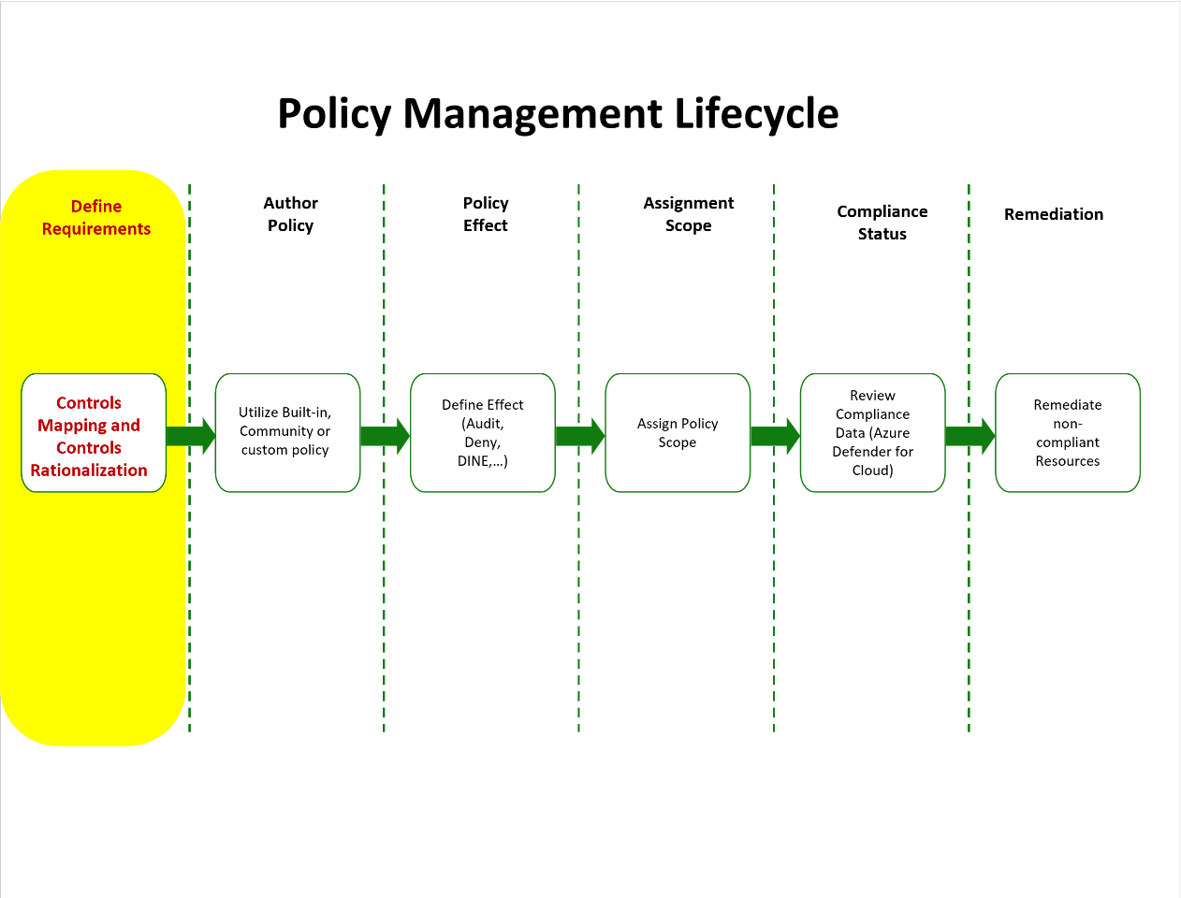

Slide 20
Azure Policies
Azure Resource Manager policies are a powerful tool in the Azure toolkit
Geo-compliance/data sovereignty - Azure provides regions across the world. Enterprises often wish to control where resources are created (whether to ensure data sovereignty or just to ensure resources are created close to the end consumers of the resources).
Cost management - An Azure subscription can contain resources of many types and scale. Corporations often wish to ensure that standard subscriptions avoid using unnecessarily large resources, which can accrue exorbitant rates per month.
Default governance through required tags - Requiring tags is one of the most common and highly desired features. Using Azure Resource Manager Policies enterprises can ensure that a resource is appropriately tagged. The most common tags are: Department, Resource Owner, and Environment type (for example - production, test, development)
Notes:
Policy to control where resources are created: Western Europe rather than East US
Policy to control what resources are created, limiting VM size
Policy to enforce resource tagging like cost management.
See next slide for example if needed.

Slide 21
Azure Initiatives
An initiative is a collection of policy definitions that are grouped together to achieve a single goal.
Initiative definitions simplify managing and assigning policy definitions. They simplify the process by grouping a set of policies as a single item
Monitor unencrypted SQL Database in Security Center – For monitoring unencrypted SQL databases and servers.
Monitor OS vulnerabilities in Security Center – For monitoring servers that do not satisfy the configured baseline.
Monitor missing Endpoint Protection in Security Center – For monitoring servers without an installed endpoint protection agent.
Notes:
The Enable Monitoring in Azure Security Center initiative can be assigned to different scopes. For example, one assignment can be assigned to subscription A. Another can be assigned to subscription B.
For example, you could create an initiative titled Enable Monitoring in Azure Security Center, with a goal to monitor all the available security recommendations in your Azure Security Center. Under this initiative, you would have policy definitions such as: Monitor unencrypted SQL Database in Security Center, Monitor OS vulnerabilities in Security Center, Monitor missing Endpoint Protection in Security Center

Slide 22
Key Points
Order of Evaluation
All policies that would apply to a resource are aggregated and evaluated at once resulting in cumulative most restrictive
Disabled --> Append/Modify --> Deny --> Audit
All processing stops on a Deny such that Deny trumps
DeployIfNotExists and AuditIfNotExists occur 10 min (customizable) AFTER the resource has been deployed
Behaviors differ for New and Existing resources
Deny on an existing resource will flag a resource non-compliant but will not modify it
DeployIfNotExists on an existing resource will flag a resource as non-compliant but will not modify it
Remediation can be triggered within the portal or via powershell on a per POLICY basis
Remediation cannot be triggered on an Initiative basis
Evaluations on new deployments happen on a per resource basis NOT cumulative to the entire deployment
This can result in some resources being deployed while others fail later in the deployment
Evaluation frequency is 24hrs
Evaluations can be triggered ad-hoc via powershell
Exemptions can be created at various scopes and are inherited.
Policies, initiative assignments and exemptions are inherited down but scope assignment does not matter
Conflicting policies will simply result in an inability to create resources
Azure Deny Assignments can only be created as part of blueprints. They are not a part of Azure Policy but rather Azure RBAC.

Slide 23
Best Practices
Identify a controls framework to start with that the organization is familiar with and review the Azure Benchmark (checklist) for that controls framework
Remember that, while checklists are a great starting point, in the GRC+ lifecycle, checklists are pretty far down the line and generally organization specific so be sure to do a control mapping to the organizations controls.
Apply the benchmark in "audit" only mode to get a feel for current state initially
Create a new Azure Policy Initiative for enforcement actions and start to build the organizational initiative.
Avoid using exemptions as they become unmanageable
Avoid applying at the resource and resource group scope (stick to management group and subscription where possible)
Use resource locks to protect critical infra components that are not modified frequently (Express Route)
Do not try to do everything at once, start with the most common/core controls. Examples would be
Logging,
Region
VM SKU
Approved Services
Public IP usage.
Do not try to apply all the production controls in sandboxes, develop a strategy for production vs non-production to reduce friction for developers. Example
Sandbox - audit controls and report/alert on incorrect controls
Non-Prod/QA - remediate non-compliant configuration and alert/notify to fix CI/CD
Prod - Deny non-compliant configuration
Apply the Azure Security Benchmarks in audit mode in addition to organizational benchmark.
These are updated by Microsoft. They do no harm to apply and can sometimes highlight control gaps in the organization.

Slide 24
Checklist
[ ]Have you decided on a Benchmark/Checklist to use as a starting point?
[ ]Have you reviewed each control in the Benchmark to understand it?
[ ]Have you done a control mapping of each control to map to organizational policies (and update the control where necessary)?
[ ]Have you applied the base benchmark/checklist to your org in audit mode and reviewed findings?
[ ]Have you identified the first 5 most critical controls you will want to start enforcing via policy?
[ ]Have you come up with a policy/management group/subscription strategy (how will you structure management groups to align with policy and how will you apply policies to align with management groups)?
[ ]Have you identified a strategy for prod vs non-prod?
[ ]Have you started to apply the bare minimum guardrails

Slide 25
Appendix

Slide 26
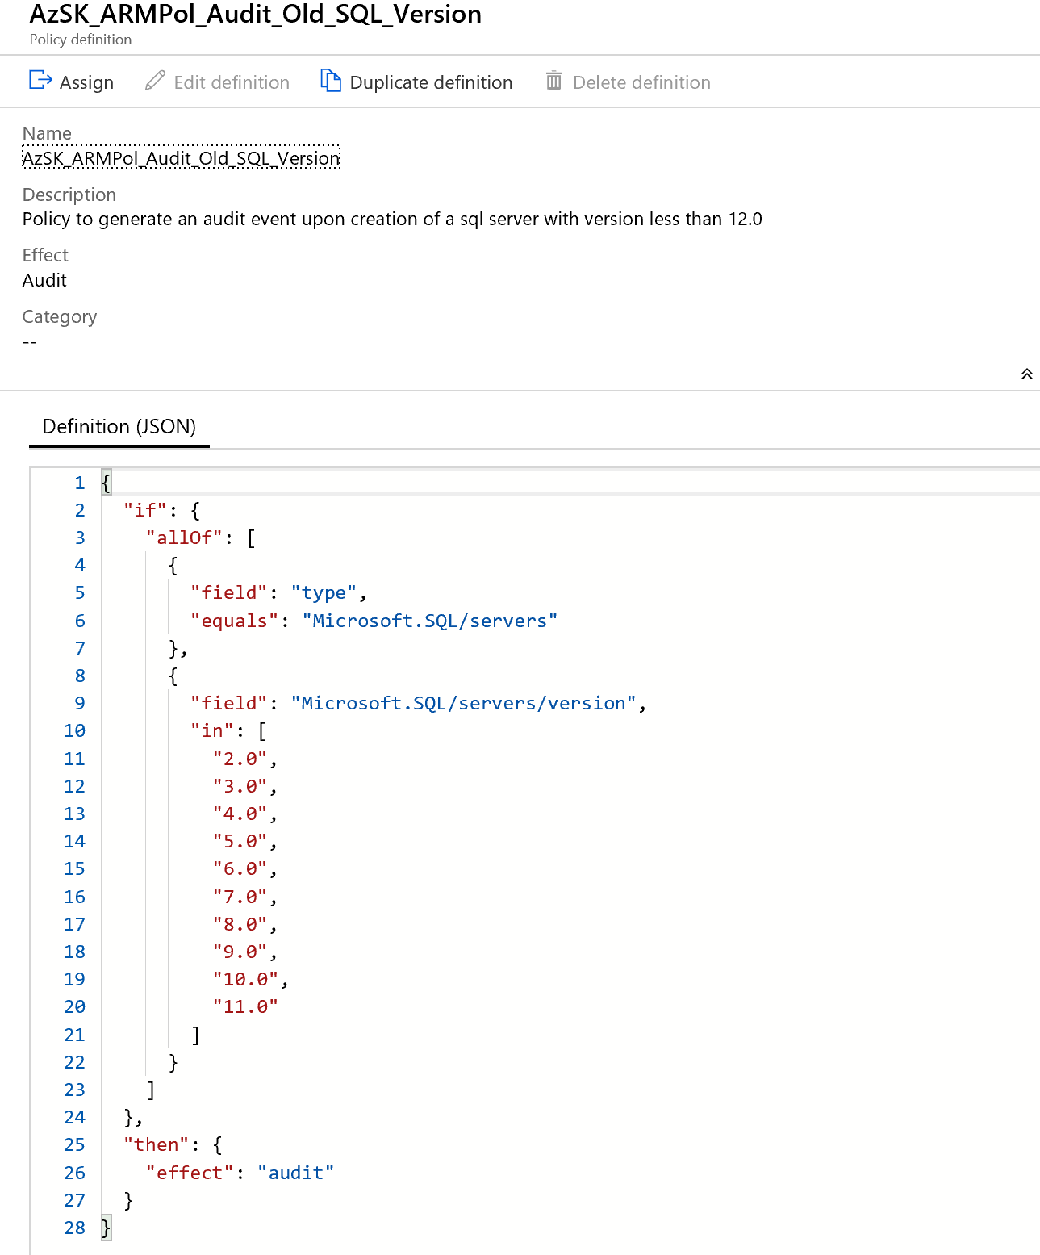
Example of a custom policy definition

Slide 27
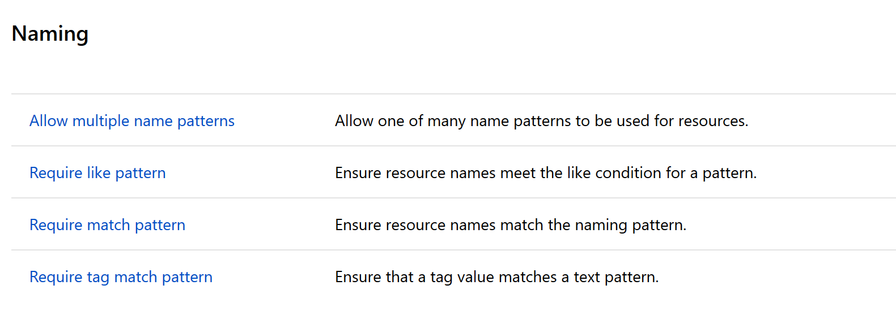
Additionnal Azure Policies Templates
Full list here:
Definition: https://docs.microsoft.com/en-us/azure/azure-policy/json-samples
Template Repository: https://github.com/Azure/azure-policy

